Slide 1
HamDash
A Briefing on the Free Real-Time Amateur Radio Dashboard
Browser-based • No account • No install • No fees
Briefing prepared July 2026

Slide 2
What is HamDash?
HamDash is a free, real-time dashboard for amateur radio operators — a single in-browser view that consolidates the live data an operator normally keeps open across many disconnected tabs.
It brings together HF propagation, space weather, DX cluster spots, POTA and SOTA activations, a contest calendar, a greyline map, field tools, and SDR receiver integration — over 30 tools in one customizable grid.
0
30+
100%
Accounts required
Integrated tools
Browser-based
Source: rtl-sdr.com, hamdash.com

Slide 3
At a Glance
Type
Free, browser-based web application (runs in Chrome / Chromium)
Builder
Peter — amateur radio operator, callsign G0LIW
Access
No account, no login, no installation, no subscription
Platforms
Windows, macOS, Linux, Android — desktop, tablet, phone, Raspberry Pi
Use case
Always-on monitor for the radio shack, second screen, or field ops
Adoption
3,400+ active users within weeks of soft launch
Source: YouTube (HamDash overview), LinkedIn

Slide 4
Core Capabilities
Propagation & Solar
DX & Activity
Activations
Live D-layer absorption, SFI, K-index, and an AI propagation synopsis from NOAA/SWPC and NASA SDO.
Real-time DX cluster spots on a greyline map; PSKReporter across 40m, 20m, 15m, 10m.
Live POTA and SOTA spots plus a contest calendar.
Weather & Safety
Field Tools
SDR Receiver
Real-time MET/NOAA data, lightning maps, and links to Skywarn/Raynet.
Antenna calculators, a Morse tutor, and a simple local QSO log.
Browser-based SDRcom with live spectrum, waterfall, and digital-mode decoding.
Source: rtl-sdr.com, LinkedIn

Slide 5
Data Sources & Integrations
Live data feeds
Integrations & tools
NOAA / SWPC space weather (solar flux, geomagnetic indices)
WebSDR links — listen to frequencies worldwide
NASA Solar Dynamics Observatory telemetry
RTL-SDR V3 / V4 dongle support
DX cluster spots & PSKReporter propagation
SDRcom Red Lite & SDRcom Pro receivers
POTA and SOTA activation feeds
Skywarn (US) and Raynet (UK) emergency nets
Contest calendar and greyline data
Antenna calculators and Morse tutor
Real-time weather and lightning (MET / NOAA)
Local QSO log
Source: hamdash.com, YouTube

Slide 6
SDR Receiver Integration
HamDash adds a browser-based SDR operating environment — live spectrum and waterfall displays, digital-mode decoding, signal analysis, and direct RF interaction — without traditional desktop software.
100 kHz – 1.75 GHz
2.4 MHz
4 platforms
Wideband frequency coverage
Instantaneous bandwidth
Windows, macOS, Linux, Android
Recommended hardware: Nooelec NESDR SMArt v5 (or RTL-SDR Blog V3/V4). HF reception below 25 MHz uses direct sampling and needs a suitable antenna.
Source: hamdash.com (recommended receiver), Facebook (HamOps group)

Slide 7
Privacy & Architecture
HamDash is positioned as a privacy-first alternative to data-harvesting apps — no central user database, no tracking, and no analytics watching the operator.
No accounts
Local-only data
No login or registration — there is no user database to compromise.
Callsign, QSO logs, and layout preferences stay in the browser; nothing stored on a server.
General location
Zero tracking
Only a broad area is used (IP-based or grid square) — never an exact address.
No analytics or monitoring of operator activity on the site.
Source: YouTube (privacy discussion)

Slide 8
Who It’s For
A single tool that serves operators across every mode of operating — from the home shack to the field.
Home shack
Field operators
Always-on second monitor or dedicated display showing bands, spots, and space weather at a glance.
POTA / SOTA activations with safety-focused weather alerts, lightning maps, and compact field tools on a tablet.
Newcomers
Listeners (SWL)
Free, no-config entry point that lowers the barrier to understanding band conditions and activity.
WebSDR links and SDR receiver to monitor frequencies worldwide from the browser.
Source: rtl-sdr.com

Slide 9
Getting Started
No installation. Open it in a browser and start operating.
1
2
3
4
Open the app
Enter callsign
Arrange layout
Add SDR (optional)
Visit hamdash.com in Chrome on any device.
Auto-detects your area; or set a grid square.
Pick from six dashboards and arrange the grid.
Plug in an RTL-SDR dongle for live spectrum.
Source: hamdash.com, Reddit

Slide 10
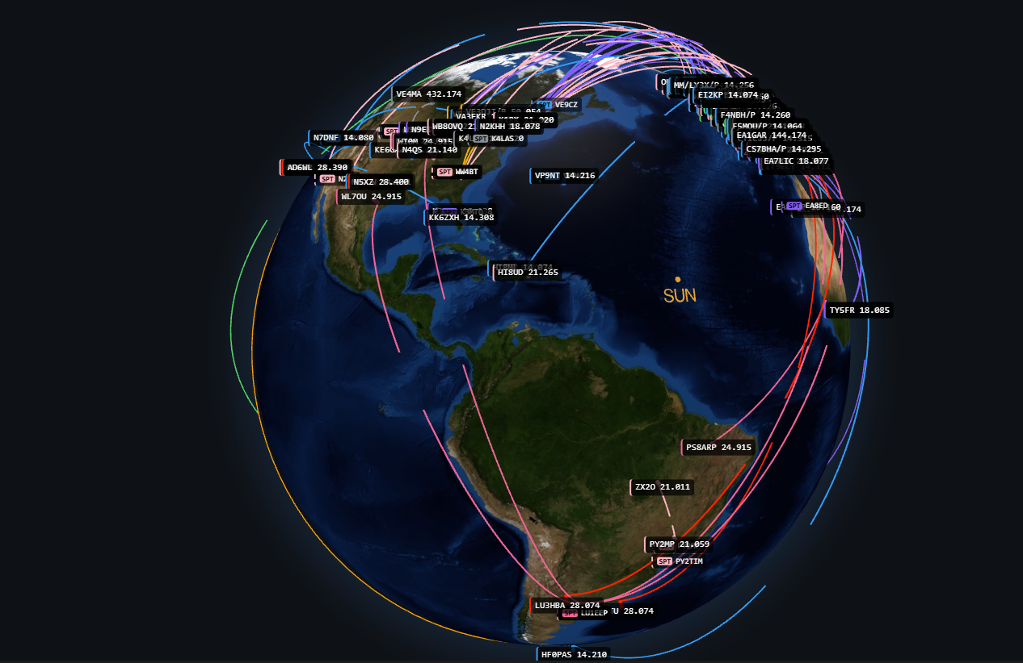
This briefing is interactive. Meaning break out your devices and customize
HAMDASH as we move along if you wish.

Slide 11
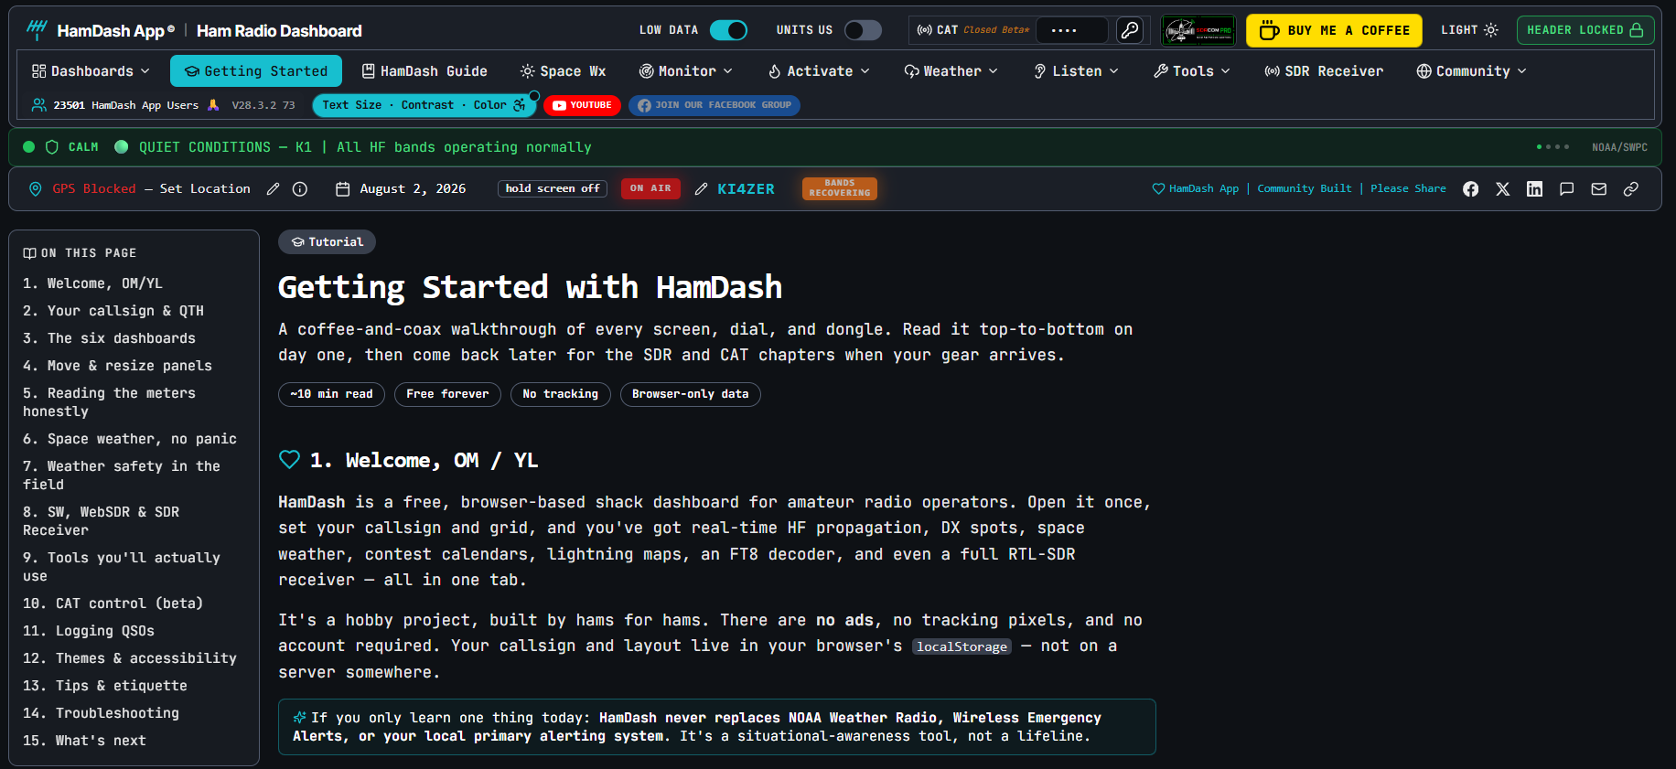
Because HAMDASH is so custonmizable, each users interface will be different

Slide 12
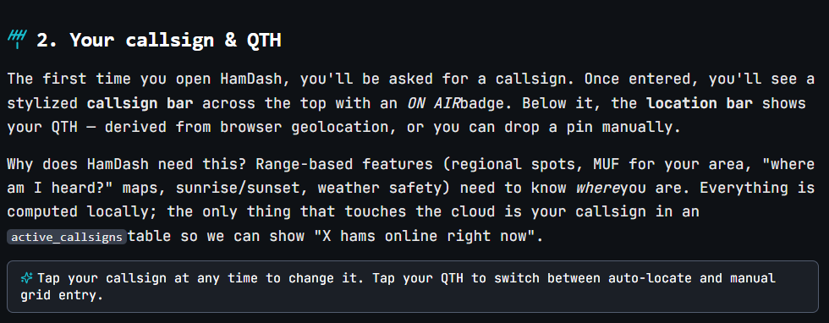

Slide 13
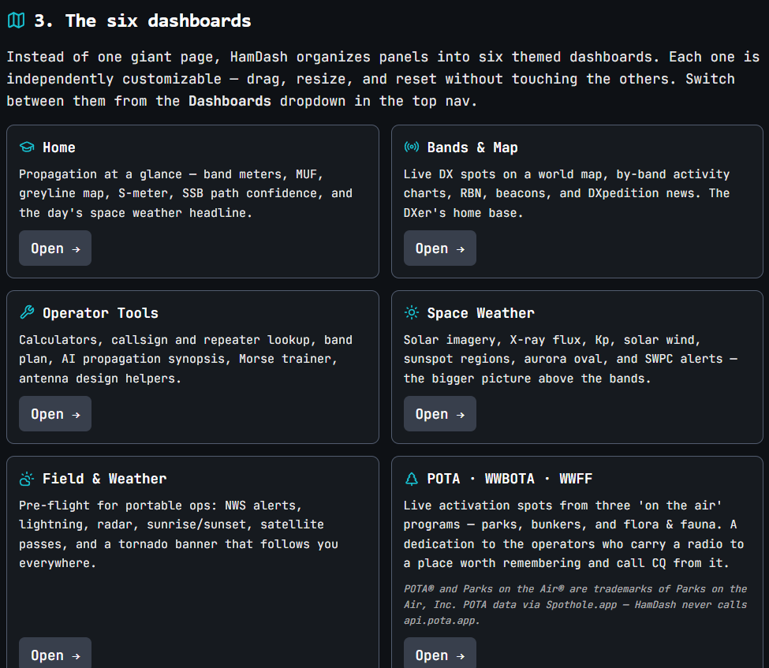

Slide 14
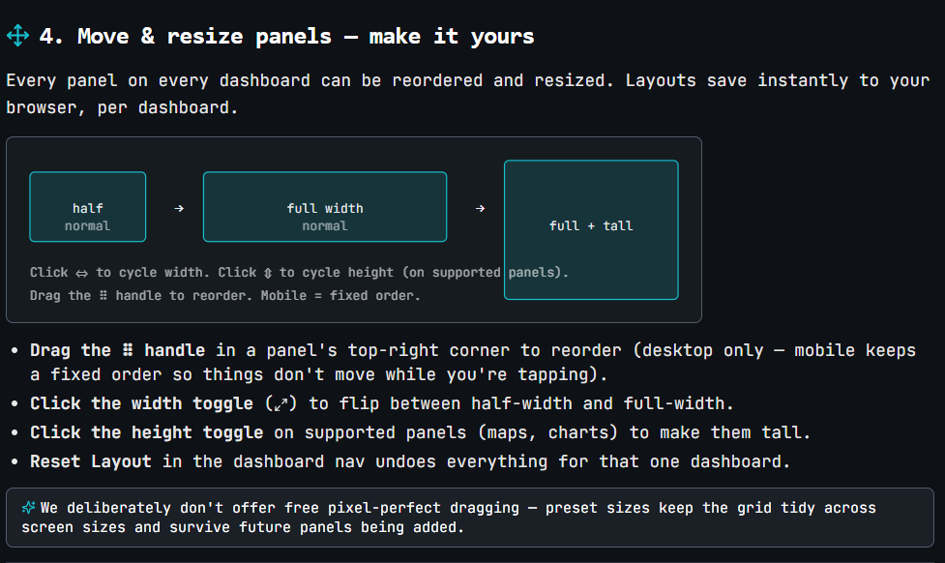

Slide 15
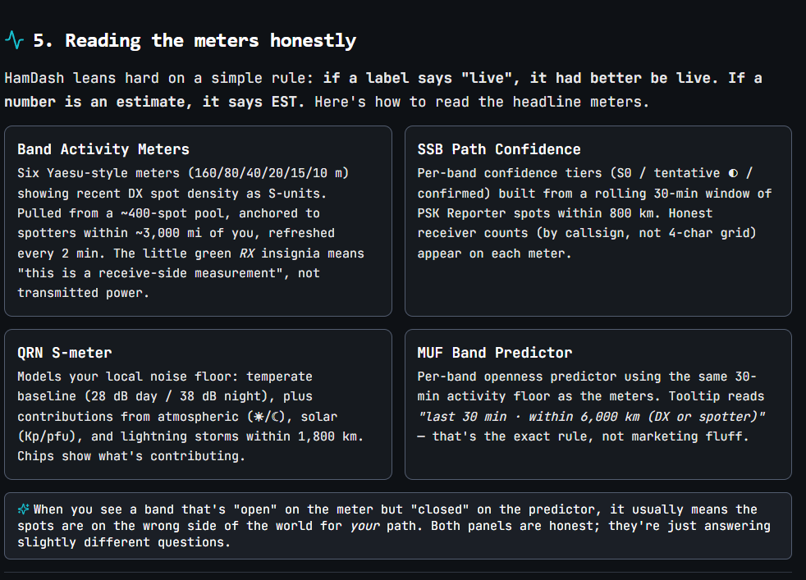

Slide 16
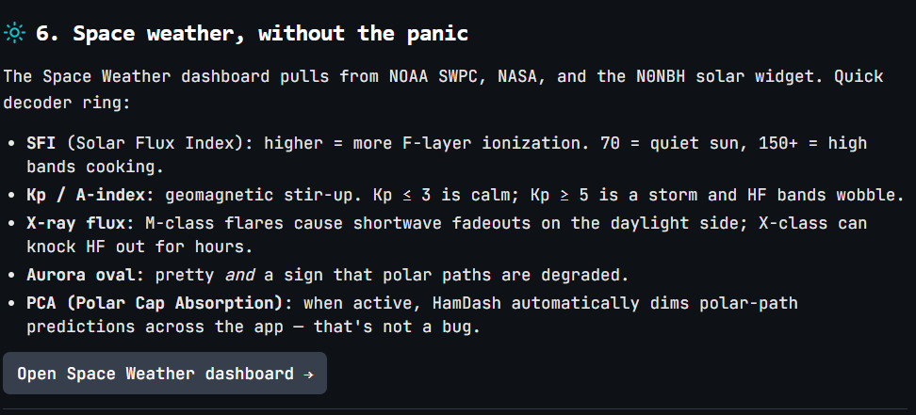

Slide 17
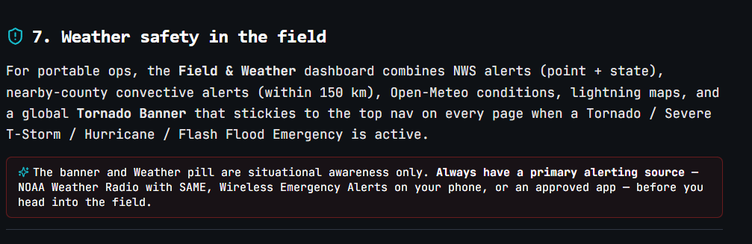

Slide 18
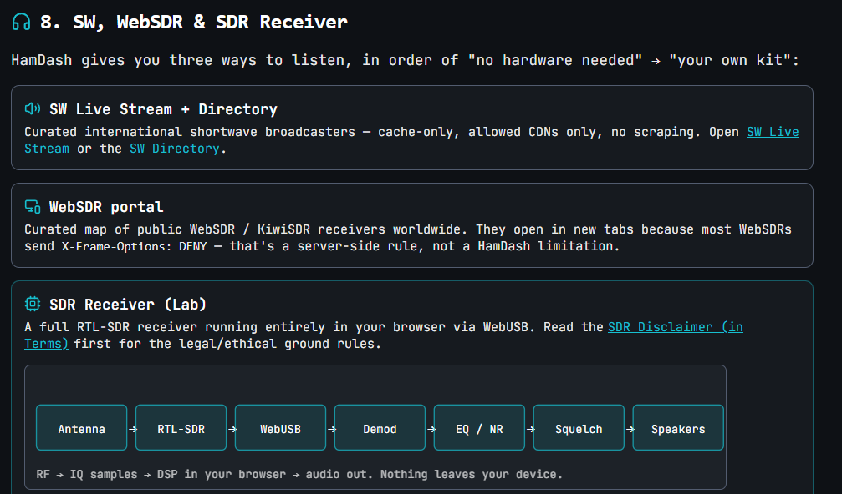

Slide 19
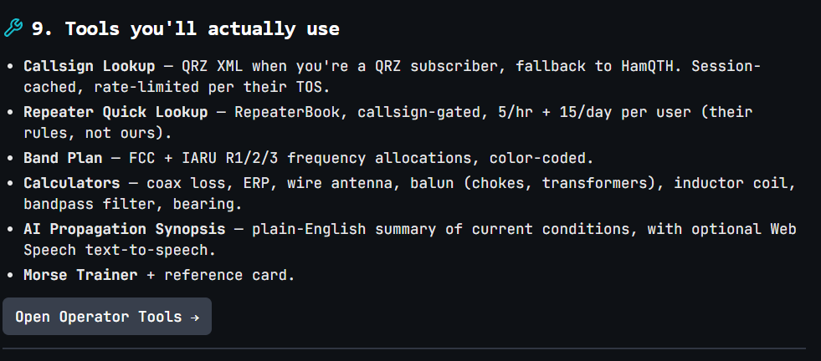

Slide 20
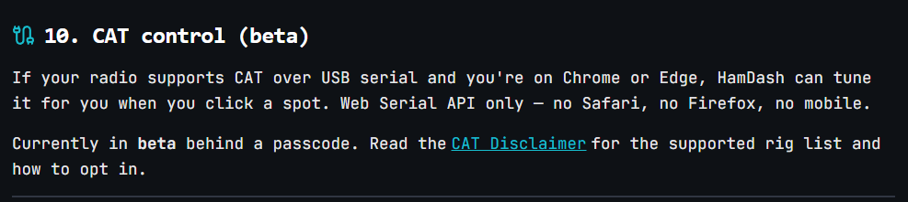

Slide 21
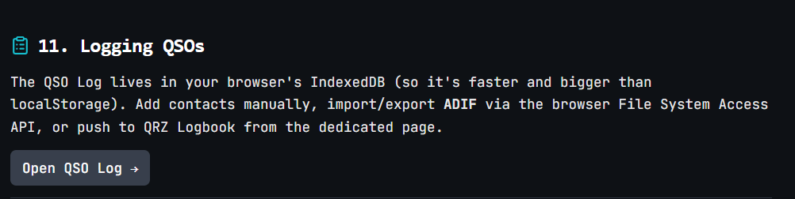

Slide 22
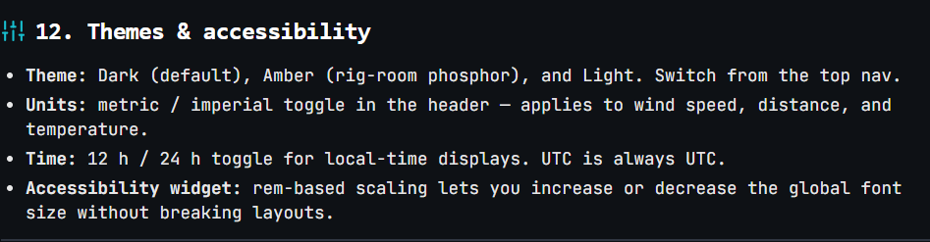

Slide 23
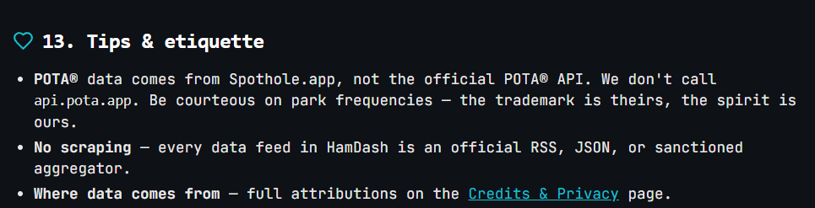

Slide 24
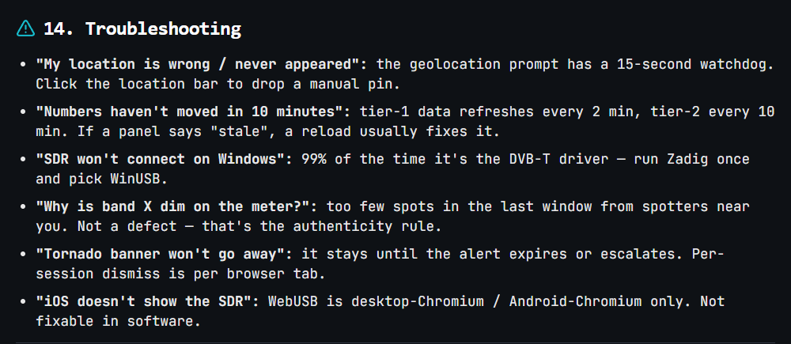

Slide 25
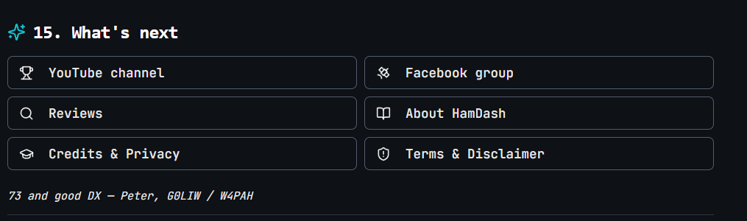

Slide 26
Takeaways
HamDash consolidates 30+ ham radio tools into one free, browser-based dashboard.
No account, no install, no fees — runs on any device with Chrome / Chromium.
Live propagation, solar weather, DX spots, POTA/SOTA, contests, and field tools in one view.
Optional SDR receiver integration (RTL-SDR) for spectrum, waterfall, and decoding.
Privacy-first: local-only data, general location, zero tracking.
Ideal for the home shack, field activations, newcomers, and SWL listeners.
Explore it at hamdash.com

