Slide 1

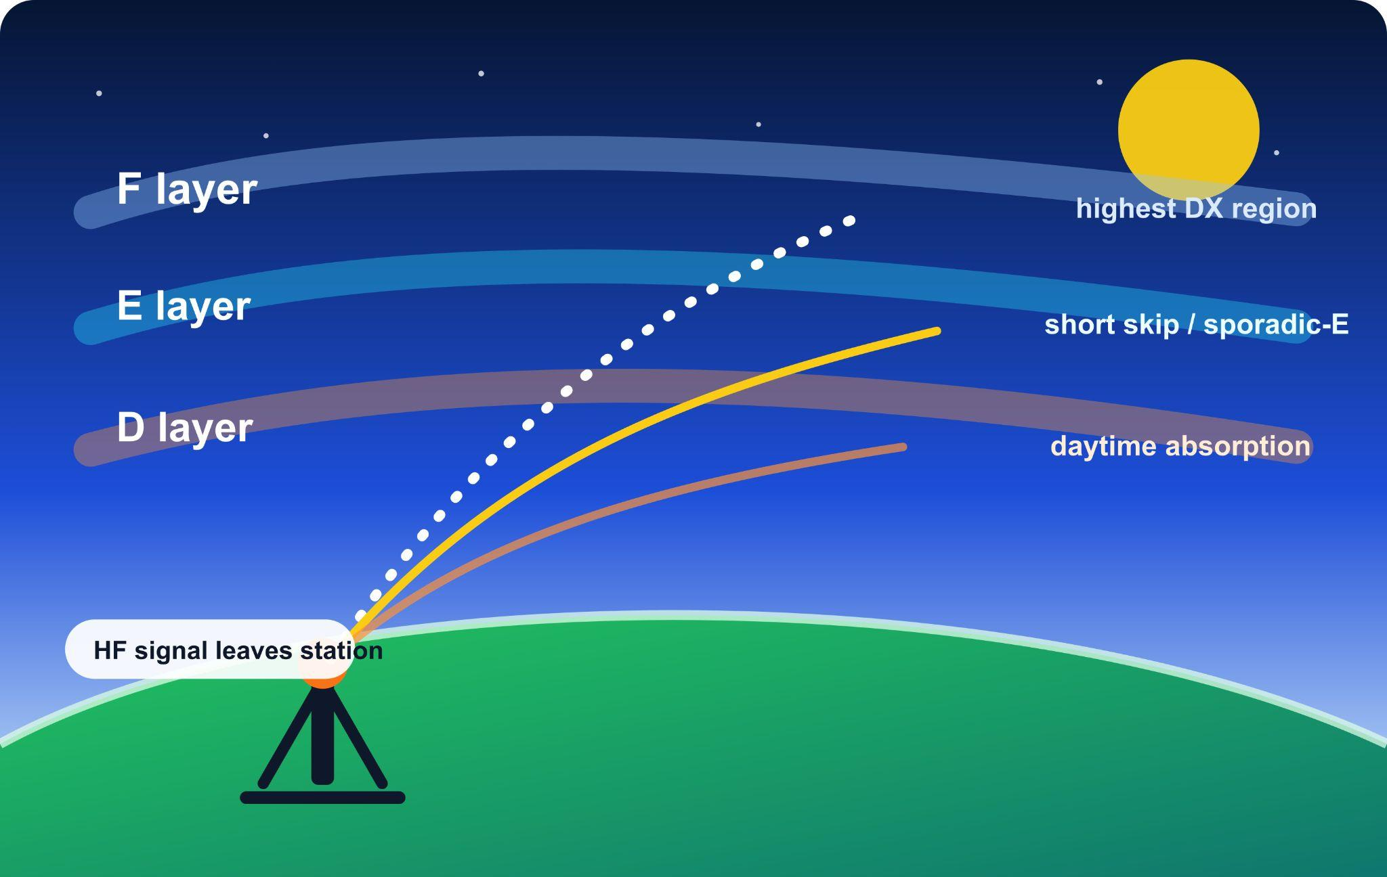
High Frequency Communications: Why Beyond Line of Sight Comms Are Important To The World
Examining and decoding various modes of HF using open source tools.
Tech Night

Slide 2
Links:
Tech Night
KIWISDR: http://kiwisdr.com/public/
https://websdr.carrd.co/
http://g8ure.ddns.net:8079/ ← 80M Dipole FSK
http://sdr.hfunderground.com:8076/ ← 500ft Beverage to Europe

Slide 3
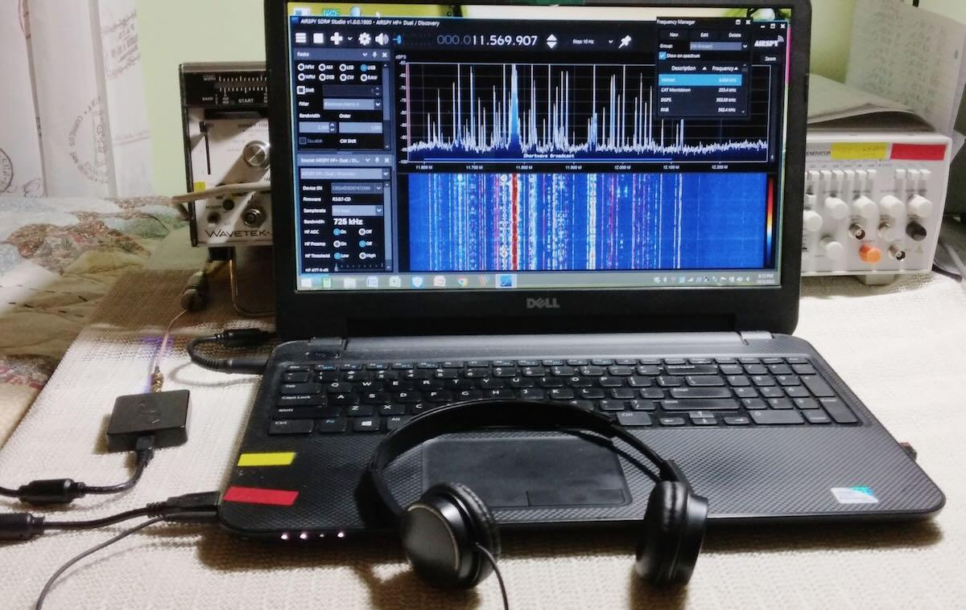
Tech Night
My Gateway Drug to Ham Radio: Software Defined Radio
A software-defined radio (SDR) system is a radio communication system which uses software for the modulation and demodulation of radio signals. An SDR performs significant amounts of signal processing in a general purpose computer, or a reconfigurable piece of digital electronics. The goal of this design is to produce a radio that can receive and transmit a new form of radio protocol just by running new software.

Slide 4

Tech Night
Hf Radio Applications:
Marine
On the high seas safety is one of your main concerns. You cannot enjoy even a basic fishing trip without the right information such as navigational, meteorological warnings and forecasts. HF radio can provide you access to valuable zero hour information by using reliable and rock solid radio technologies.

Slide 5
Marine HF Modes
Tech Night
Frequency Shift Keying, Frequency-shift keying sends one bit by playing one of two tones. AudioCipher's FSK mode uses a 1000 Hz tone for a 0 and a 1200 Hz tone for a 1, transmitted at 45 bits per second by default. FSK is one of the oldest digital modulation methods still in daily use, and it earns its place by being almost embarrassingly simple to build and hard to confuse in noisy conditions.
Automatic Link Establishment, commonly known as ALE, is the worldwide for digitally initiating and sustaining HF radio communications. ALE is a feature in an HF communications radio transceiver system that enables the radio station to make contact, or initiate a communications circuit, between itself and another HF radio station or network of stations. The purpose is to provide a reliable rapid method of calling and connecting during constantly changing HF ionospheric propagation, reception interference, and shared spectrum use of busy or congested HF channels.
Driftnet Radio Buoys (DRB) A driftnet beacon is a battery-powered radio transmitter installed inside a marine buoy. This "radio buoy" / "fishing buoy" / "fishery buoy" is tied to the end of an ocean drift net, or occasionally, a longline . The signal allows fishermen to perform RDF (radio direction finding) techniques to determine the exact location of the net after it's been deployed a while.
SITOR-B is one of two modes of SITOR (Simplex Teletype Over Radio). NAVTEX and AMTOR-FEC/AMTOR-B uses the SITOR-B protocol. Based on CCIR 625 This mode is often used in broadcasts of navigational and other warnings from maritime stations. https://www.youtube.com/watch?v=JzIGZO02UKQ

Slide 6
Marine HF Modes
Tech Night
Global Maritime Distress and Safety System's Digital Selective Calling System is a maritime communication protocol using FSK, quite similar to SITOR and used on VHF, MF and HF marine bands. CCIR 493-4 Selcall, also known as HF Selcall, Australian Selcall, and Codan 8580 Selcall, is a Selcall standard developed in Australia for the HF band. Used by Amateur radio and many HF modems.
Weather FAX (WEFAX) was thought to be going dead years ago, but continues to be heavily used. There are even reports of the Japanese news agency (KYODO) sending newspapers (in Japanese) to fishing fleets. It should be noted that FAX use by other press services died out years ago. There are numerous applications that can copy this mode.
Coastal ocean dynamics applications radar (CODAR) is a type of portable, land-based, high frequency (HF) radar developed between 1973 and 1983 at NOAA's Wave Propagation Laboratory in Boulder, Colorado. CODAR is a noninvasive system that can measure and map near-surface ocean currents in coastal waters. It is transportable and can produce ocean current maps on site in near real time. Moreover, using CODAR it is possible to measure wave heights and produce an indirect estimate of local wind direction.

Slide 7
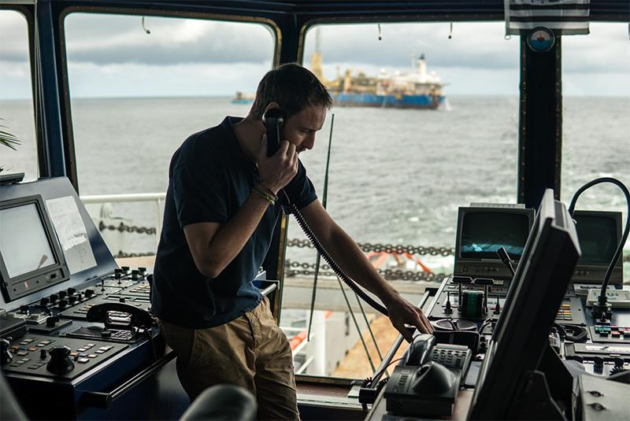
Marine HF Modes
Tech Night
PACTOR is a radio modulation mode used by amateur radio operators, marine radio stations, military or government users such as the United States Department of Homeland Security & its cybersecurity agency CISA, and radio stations in isolated areas to send and receive digital information via radio. PACTOR is an evolution of both AMTOR and packet radio; its name is a portmanteau of these two technologies' names. PACTOR uses a combination of simple FSK modulation, and the ARQ protocol for error detection and data throughput.

Slide 8
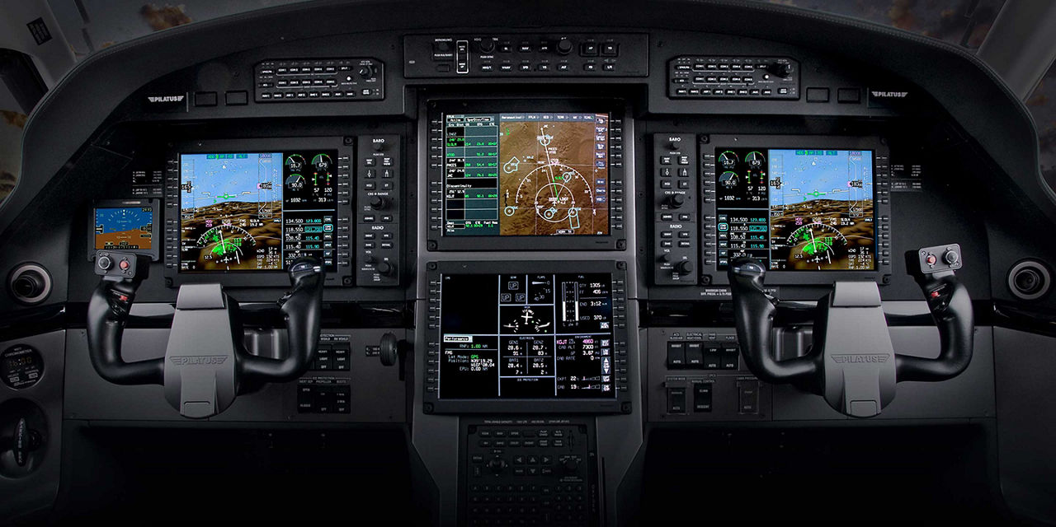
HF Radio Applications:
Aviation
Thousands of planes cover the globe every day so HF and VHF radio systems each fill important roles in aviation. HF covers long-distance communication past the horizon, while VHF gives pilots and controllers clear, reliable links within shorter ranges, especially in busy airspace and critical phases of flight.

Slide 9
Aerospace HF Modes
Tech Night
Major World Air Route Areas (MWARA) are 11 designated regions managed by the ICAO High Frequency (HF) Radio Network to provide voice communication coverage over vast oceanic and remote areas where VHF radio and radar are ineffective. These areas ensure continuous air traffic control contact via upper side band transmissions, primarily in English, supported by ground stations ranging from New York to Tokyo
High Frequency Global Communications System, HFGCS for short, is a series of networks created by the United States Air Force to send coded messages to deployed aircraft. There are seven frequencies used by the system, but some messages are usually transmitted on one frequency. When a message is transmitted on one or more (Sometimes even all) of these frequencies, an echo can be heard in the transmission. Those that broadcast these messages are given code names, some examples are 'Backyard', 'Racetrack', or 'Apathy'. The messages are decoded in a NATO phonetic-numeral alphabet. There is no channel marker for these frequencies. The messages are sent through EAMs, or Emergency Action Messages.
High Frequency Data Link, also known as HF-ACARS, ARINC 753, ARINC 635, and HF DATALINK,is a data link that aircraft use to communicate short messages over long distances using HF signals. HFDL is defined in ARINC spec 753.
Transmissions on HF are in USB on a sub-carrier of 1440 Hz with a symbol speed of 1800 baud. Data is sent at 300, 600, 1200 or 1800 bps. HFDL can use BPSK, QPSK, and 8-PSK.

Slide 10
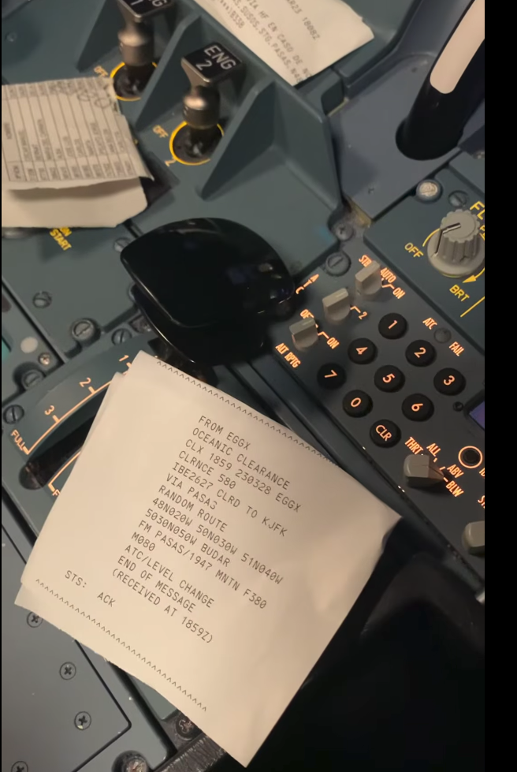
Aerospace HF Modes
Tech Night
CAO Selcal (also known as AVCALL, ANNEX 10, or just SELCAL) is a HF/VHF aviation selective calling system used by ground stations to initiate radio communications with aircraft. This mode is defined by the International Civil Aviation Organization (ICAO)
The first version of Selcal in 1985 used only 12 tones (A through M except I). In 1994, the standard was extended to have 16 tones, adding tones P, Q, R, and S. With the 16 tone format, the number of possible allowable codes was extended to 10,920. Selcal codes assigned to aircraft previously use a subset of only twelve letters/tones. Therefore, more than one aircraft may be designated by the same code

Slide 11
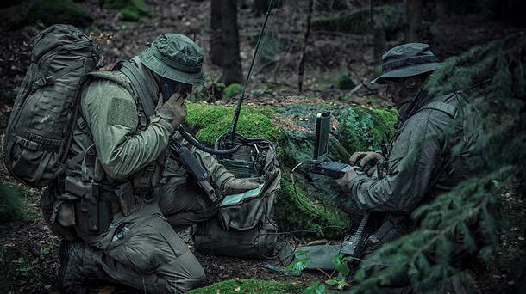
Tech Night
Hf Radio Applications:
Military
The US military, NATO and its allies must always have a means to communicate even under the toughest conditions. Adversarial nations are working on anti-satellite weaponry so it is necessary to be able to communicate in difficult environments. High frequency communications are the bedrock of today’s military, from Battle Force Mail over HF to Tactical Encrypted Data Links. They have mastered modern radio communications.

Slide 12
Aerospace HF Modes
Tech Night
STANAG 4197 is a NATO QPSK OFDM signal used in Advanced Narrowband Digital Voice Terminal (ANDVT or AN/DVT)modems that transmit encrypted digital voice over HF. These modems include the ANDVT MINTERM KY-99A modem.
STANAG 4197 is defined as "Modulation and coding characteristics that must be common to assure interoperability of 2400 bps linear predictive encoded digital speech transmitted over HF radio facilities". This signal utilizes similar waveforms to the MIL-STD-188-110A/B Appendix B waveform but this does not utilize the 393.75 Hz pilot tone, and has a unique preamble that differs from the App. B waveform.
Customs Over The Horizon Enforcement Network, or COTHEN, provides communications support for more than 235 aircraft, marine interdiction vessels, command offices, and numerous allied agencies including the USCG, DEA, Border Patrol, Army, Navy, and Joint Interagency Task Forces. COTHEN's Technical Service Center (TSC) provides real-time on-the-air support services and guarantees communications between users. COTHEN provides telephone patch (TRICS), a platform tracking and location system (TRACS), and over-the-air-rekeying capabilities (DARK).
COTHEN uses a Rockwell/Collins ALE (Automatic Link Establishment) protocol to connect users to each other over the HF spectrum. If you listen to frequencies in use on the COTHEN network, you will hear the ALE sounding calls which units periodically and automatically initiate to determine the best frequency to use for calls to other units.

Slide 13
Aerospace HF Modes
Tech Night
NATO BRASS (Broadcast and Ship to Shore) is HF radio system definition for long-range communication between naval vessels and shore stations. Continuous broadcasting from shore over wide coverage areas over multiple HF frequencies can deliver messages to multiple ships. Therefore, NATO BRASS enable ships in EMCON (Emission Control – Radio Silence) to still receive critical broadcast messages.
Link-11 (Also known as ALLIGATOR, STANAG 5511, TADIL-A, MIL-STD-6011, and MIL-STD-188-203-1A) is a Tactical Data Link standard (formerly known as Tactical Digital Information Link (TADIL) used by NATO and the US Military for Maritime Tactical Data Exchange.
Link 11 is used to exchange digital information among airborne, land-based, and ship-board tactical data systems. It is the primary means to exchange data such as radar tracking information beyond line of sight. In addition, it is used for radar coordination and weapons fire control.

Slide 14
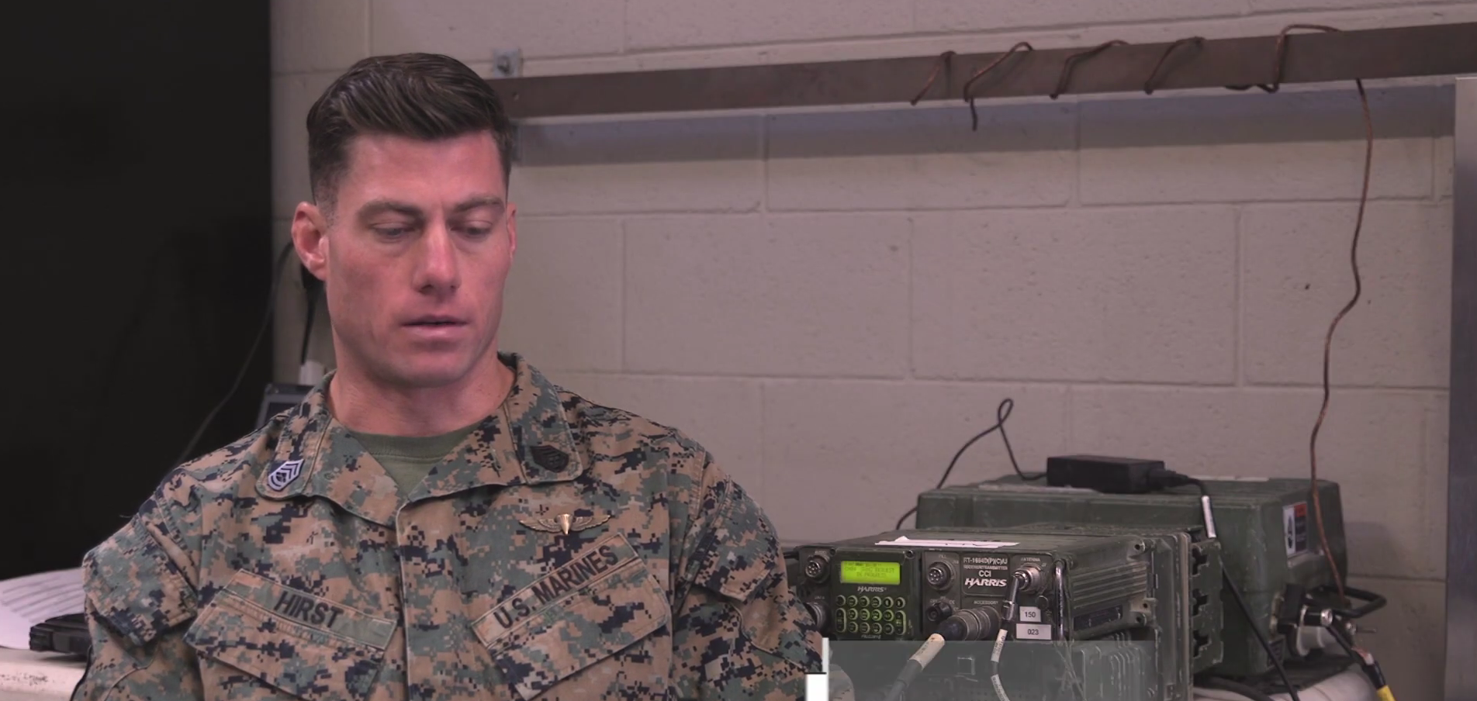
Aerospace HF Modes
Tech Night

Slide 15
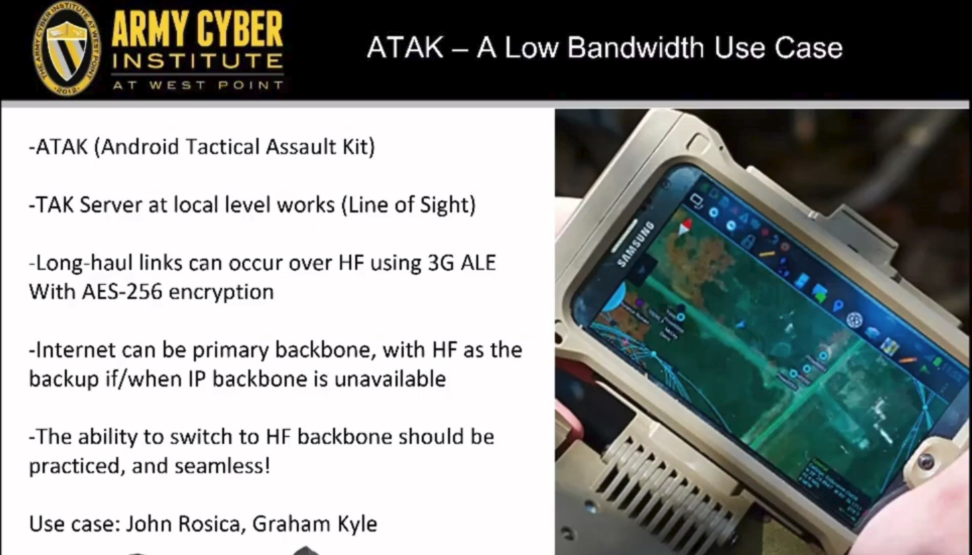
Aerospace HF Modes
Tech Night

Slide 16
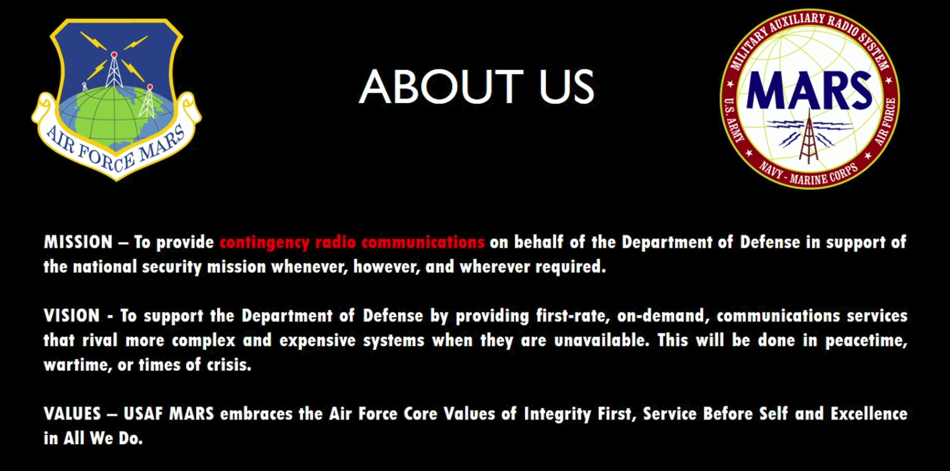
Aerospace HF Modes
Tech Night

Slide 17
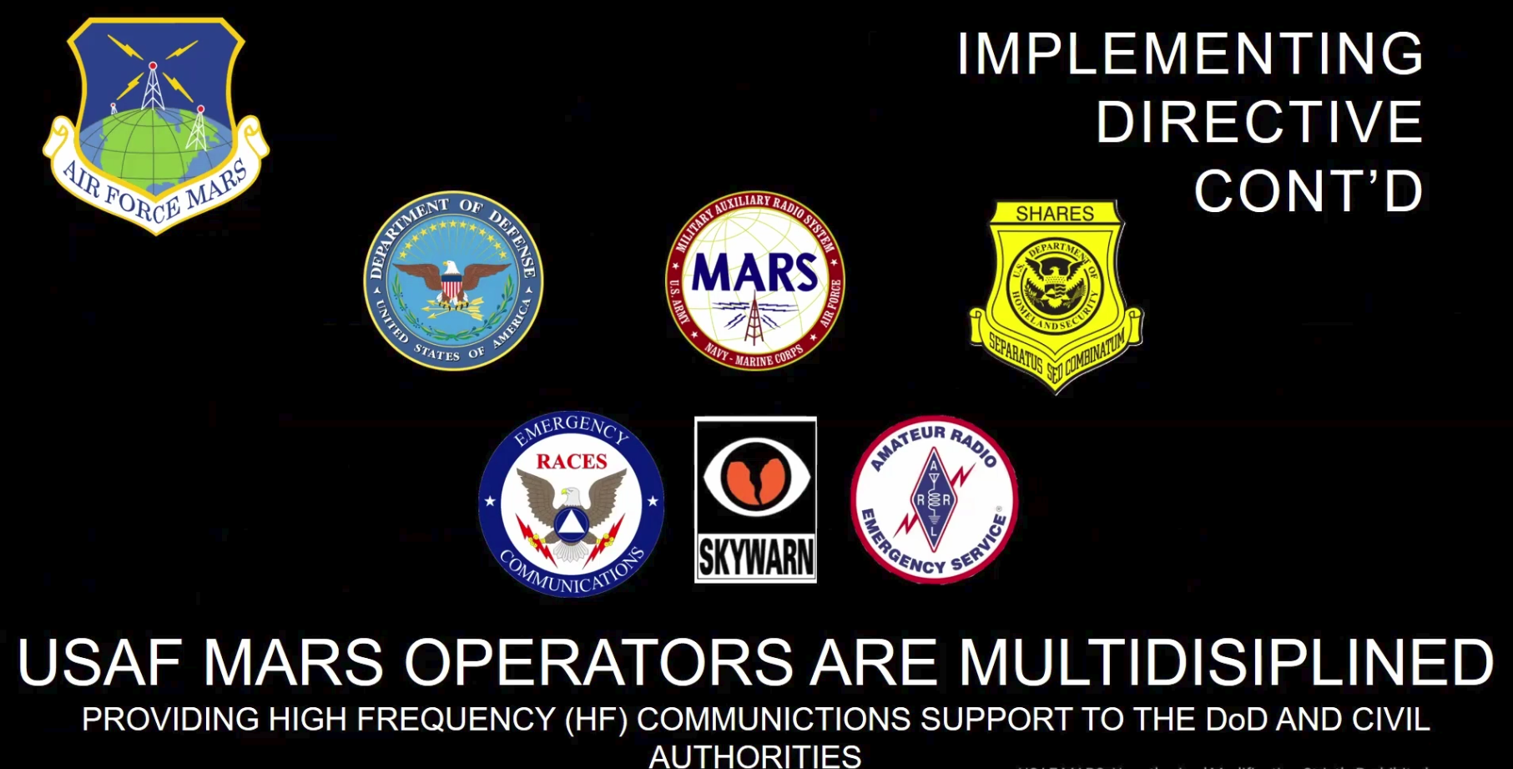
Aerospace HF Modes
Tech Night

